Slide 1


Credit Card Fraud Detection
Adil Khan
Notes:
The following is a presentation of my project that looks at credit card fraud and how to detect such transactions. The Enclosed Data Analysis Project aims to build a machine learning model that has the capability to predict with great accuracy when a credit card transaction presents as being fraudulent.

Slide 2
What is Credit Card Fraud?
Credit card fraud means using a person’s credit card without his knowledge by means of withdrawing funds or purchase of goods.
The most common ways of card theft are done by stealing the card before it is received by the owner, getting the card details from the owner via phone calls, Sending inappropriate links to the owner’s mobile to get the card details, appropriation of lost cards and so on.
Notes:
Beginning with Exploratory data analysis, I will use machine learning algorithms to understand and work through these data. By exploring the data set and understanding trends, I will build and train a model to predict which transactions are fraudulent, ultimately aiming to test and select the most accurate model for this set of data.

Slide 3
Why this is important?
Notes:
These data are important to analyze as our world becomes increasingly automated and electronic. With credit card fraud on the rise both here inthe United States and abroad, we must continue to bediligent about finding ways to cut through the falsehoods. The produced model could be immensely useful in today's world of online shopping, where millions of transactions occur daily, many of them fraudulent.
These data are important to analyze as our world becomes increasingly automated and electronic. With credit card fraud on the rise both here in the United States and abroad, we must continue to bediligent about finding ways to cut through the falsehoods.
The produced model could be immensely useful int oday's world of online shopping, where millions of transactions occur daily, many of them fraudulent.

Slide 4
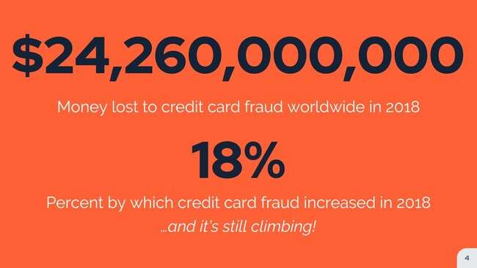
Notes:
Visualizing these numbers helps understand just how prevalentthis topic is in the modern world.With $24.2 billion being lost to credit card fraud worldwidejust in the year 2018, and with credit card fraudrising by 18% in that same year, the rate ofcredit card fraud continues to rise today.

Slide 5
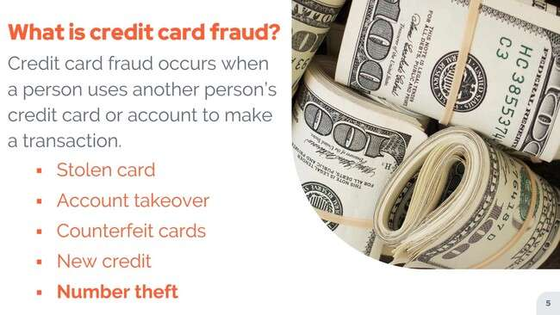
Notes:
Credit card fraud occurs when a person uses anotherperson's credit card or account to make a transactionwithout the proper authorization to do so.In addition to making this unauthorized transaction, creditcard fraud can lead to information theft andcontinued unauthorized use of your accounts.
There are several different types of credit card fraud.A stolen card means a personis physically using your card account.Takeover happens when another personeffectively controls your bank account.Counterfeit cards can be created by copying a card.
New credit cards can be obtainedby falsely using another person's information.And finally, in the main focus ofour data set is number theft.When a credit card does not need to bepresent, but the card number is used, this iswhere the greatest increase is being seen, as onlineshopping presents a large opportunity and a large amountof traffic for this to occur.

Slide 6
ABOUT THE DATA
WORDLINE AND MACHINE LEARNING GROUP
Notes:
The data being used here comes from theorganization Worldline and the Machine Learning Group.
This is a card transaction dataset that consists of a combinationof fraudulent and non fraudulent transactions.

Slide 7
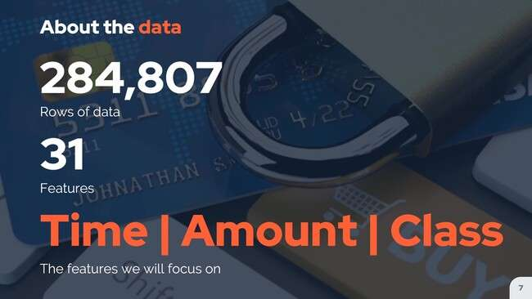
Notes:
As we take our first look at thedata, we find out a few key characteristics.This data set contains 284,807 rows ofdata and 31 different columns or features.Just three of these features will be the focus ofthe project, and those are time, amount and class, withclass being classification of fraudulent or non fraudulent.

Slide 8
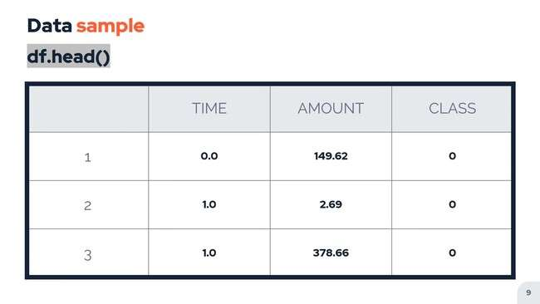
Notes:
Following the initial look at our data, we willcontinue on to explore it a bit further.By running the head function, we get a glimpseof the first several roles of our data.We can see that our time, amountand class variables are all present.

Slide 9
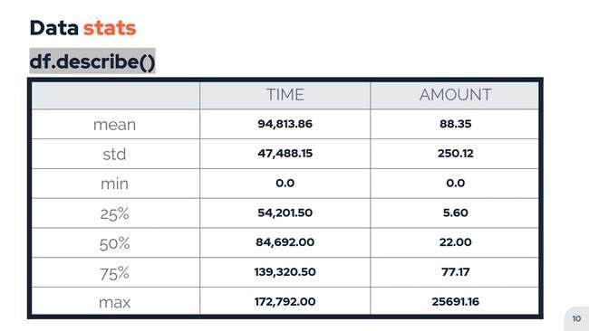
Notes:
By then running the describe function, we cantake a deeper dive into the datasets.We are able to see such descriptivenumbers as the mean, minimum and maximumvalues for our time and amount variables.Our time variable is recorded in thenumber of seconds passed since the veryfirst transaction in the data set.

Slide 10
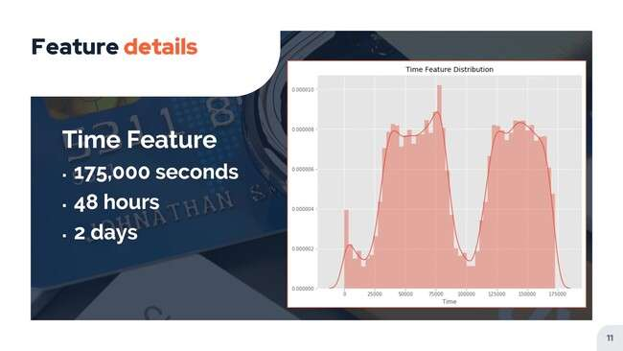
Feature Details
Notes:
Our time variable is recorded in thenumber of seconds passed since the veryfirst transaction in the data set.Because we have approximately 175 0 second worth ofdata, we can conclude that our data set wasrecorded over about 48 hours or two days time.By visualizing this time period, we areable to quickly see something interesting.We see that just about halfway through thedata collection, the volume of transaction decreases significantly,followed by a quick increase shortly thereafter.Without knowing the exact time of day, wecan realistically make the assumption that this dropin activity occurs during night time hours.

Slide 11
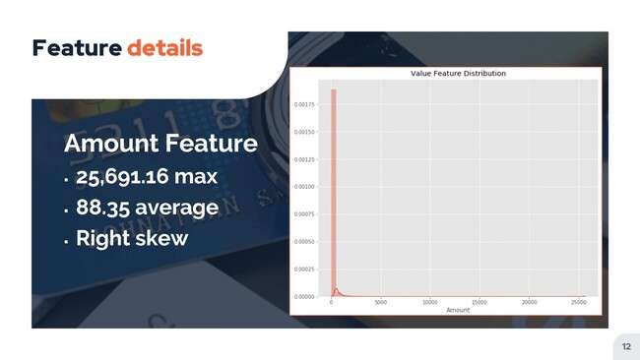
Feature Details
Notes:
Our maximum transaction is for an amount of $25,691.16,but combining that with our mean of $88.35 iseasy to suspect a strong skew to the right,with the majority of transactions having a much smallervalue than our maximum transaction.

Slide 12
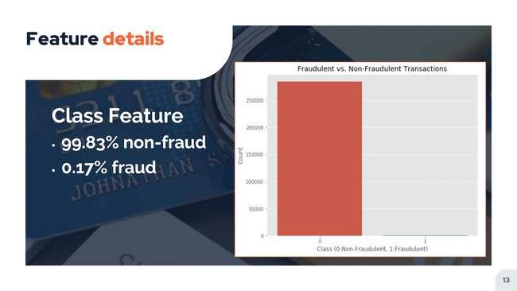
Feature Details
Notes:
Interestingly, we also find out that the vast majorityof the transactions are non fraudulent, with fraudulent transactionsonly occurring 00:17 percent of the time.

Slide 13
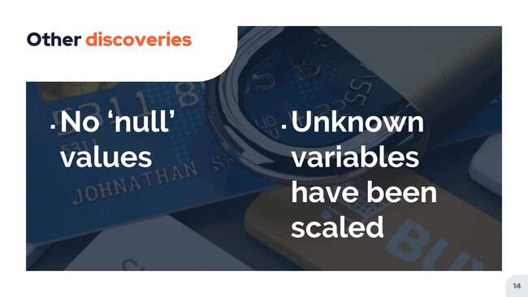
Other Discoveries
Notes:
A couple of other discoveries while exploring ourdata is that we do not have anynull values to manage and that our unknownvariables have already been scaled for our analysis.

Slide 14
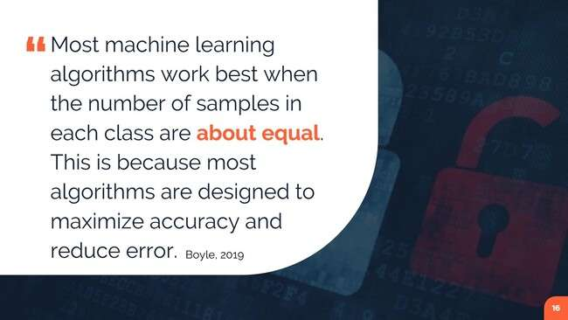
Data Preparation
Notes:
After exploring our data, the next thing weneed to do is prepare it for analysis.In the following steps, we will addressthe data imbalance outliers and more.
We call that our original data setis greatly imbalanced, with the vast majorityof transactions being non fraudulent.If we were to continue with this datasetas is, without adjusting for this imbalance, werun the risk of overfitting with our algorithms.Since the assumption will likely be made that mosttransactions are not fraudulent, we are looking for amodel that will detect patterns rather than assume outcomes,so we want to account for this imbalance beforecontinuing on with our analysis.

Slide 15
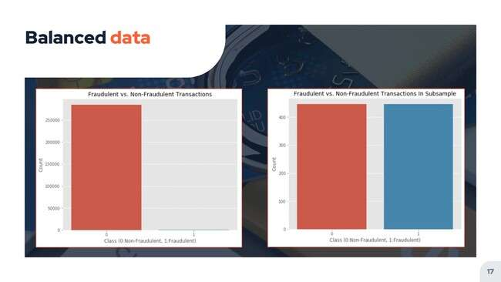
Balanced data
Notes:
To create the Balance training set to be used,first, we can count the number of fraudulent transactionsthat exist in the original data set.By randomly selecting the same number of non fraudulenttransactions from the data set, we will end upwith a 50 50 mixture of transactions.
We want to then concatenate the two listsand shuffle to randomize the class type.Since we have 435 fraudulent transactions in ourlist and thus have selected the same numberof non fraudulent transactions, our new data setwill contain 870 total transactions.
By visualizing the class distribution in the original dataset compared to the newly created subsample, we caneasily see how much more balanced it has become.

Slide 16
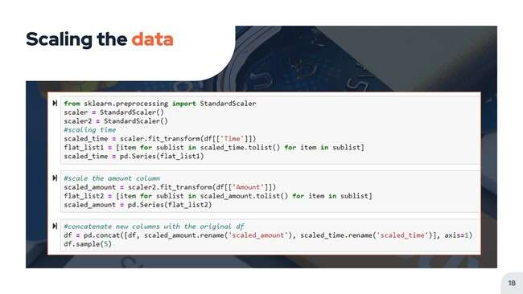
Scaling the data
Notes:
We know through our initial discovery that ouranonymous columns have already been scaled for us.Before moving on into our full analysis ofour dataset, we will need to scale ourtime and amount features as well.Without scaling these features, we risk poorperformance of our machine learning algorithms.
To standardize these features, we can usethe standard scalar function from Fklearn.Using this tool transforms the data such thatits distribution will have a mean value ofzero and a standard deviation of one.
This allows our features to have a common scale forus to be able to build our machine learning algorithm.

Slide 17
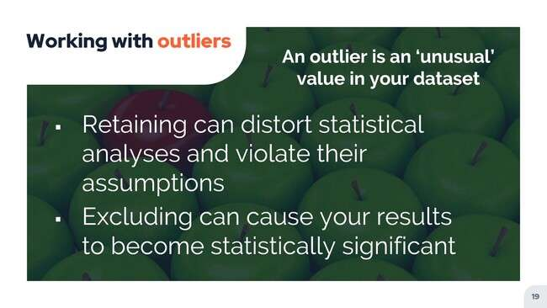
Working with outliers
Notes:
One important step to analyzing data is to identifyand work with any outliers that may exist.The way you deal with outliers can havea significant effect on your data and ultimatelythe power of your model's predictions.
We have to be somewhat careful with howwe define our thresholds for removing outliers.
A lower threshold will remove more outliers.However, perhaps we want to limit those removalsonly to extreme outliers in order to retainmost of our data, thus limiting the riskto our model accuracy in both directions.
A data point is typically considered to be an outlierif it lies outside of 1.5 times the IQR.
But with our data set, using thisthreshold would significantly reduce our training size.

Slide 18
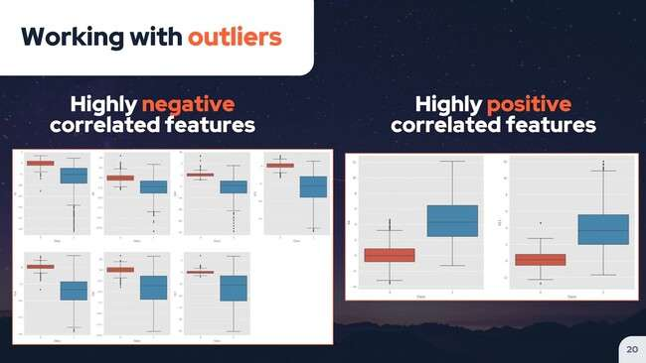
Working with outliers
Notes:
For this reason, we will elect to only remove thesepoints sitting outside of 2.5 times the IQR for outlierremoval of this data set, I chose to look atfeatures with a correlation of .5 or more with theclass variable, which is fraudulent or not fraudulent.
First, we can visualize the positive andnegative correlations with different features before wego ahead and actually remove any outliers.We calculate our inner cordial range or IQRand use box plots to display our data.Box plots are a good tool for this becausewe can easily see the 25th and 75th percentilesas well as identifying any extreme outliers.
By using these specifications, we reduce oursubsample from 870 transactions to 612 transactions.

Slide 19
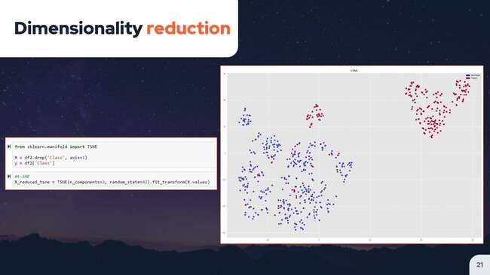
Dimensionality Reduction
Notes:
Since we are not able to visualize ourclasses multi dimensionally at this point, we canuse a dimensionality reduction method to project higherdimensional distributions into lower dimensional visualizations.
The Tdistributed Stochastic Neighbor Embedding, or tSNE algorithm offersa way to get a feel for how ourdata is arranged in a high dimensional space.This algorithm calculates a similarity measure betweenpairs of instances in the high dimensionaland low dimensional spaces, and then attemptsto optimize the two measures by quantifyingthe error between predicted and expected values.
TS and E can do a goodjob of clustering the transactions that werefraudulent and nonfriendly in our data set.By using TS and E and showing our dataon a two dimensional space, we can here seea scatter plot of the resulting clusters.

Slide 20
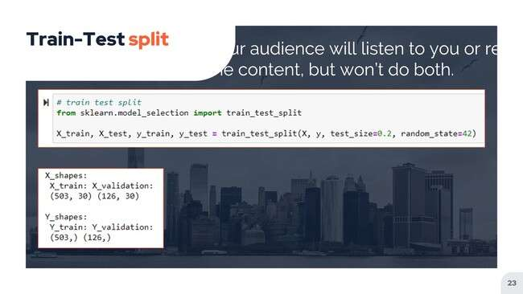
Train – Test SPLIT
Notes:
Now that we have prepared and cleaned our dataset so that it is workable, we need toproceed and train and test our classification algorithms.Before doing so, we first perform an 80 20 train testsplit on the data, which splits it into two parts.I used the KFold cross validation methodfor resampling in order to avoid overfittingfor a somewhat limited sample.
This method involves shuffling the dataset, splitting itinto K groups, working with each individual group,and then summarizing the model ability using asample of model evaluation scores.

Slide 21
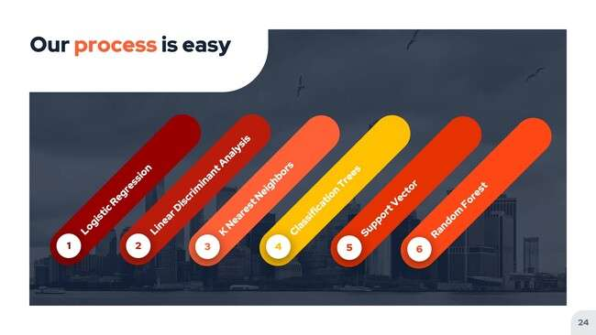
Process
Notes:
Next, we can look at the different classificationalgorithms that are available to us and howthey might perform for our current data.By comparing several algorithms and visualizing their performance ata glance, we can make an educated decision aboutwhich one to use for our model.
I compared a handful of commonly usedclassification algorithms side by side logistic regression,linear discriminant analysis, knees, neighbors, classification trees,support, vector, and random forests.

Slide 22
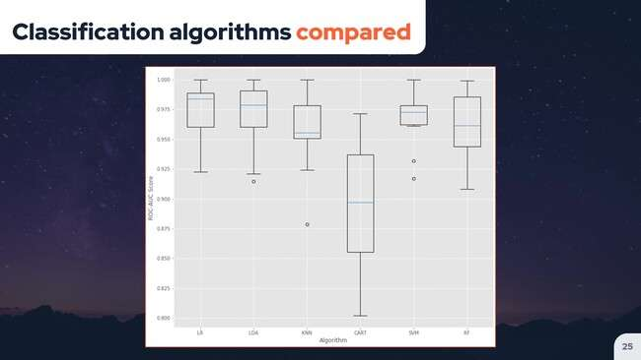
Classification Algorithm Compared
Notes:
We can see that several of the compared algorithmsshow similar results, but a few outperform the rest.Namely logistic regression algorithm, looks to be moreaccurate than the alternative classifiers for our data

Slide 23
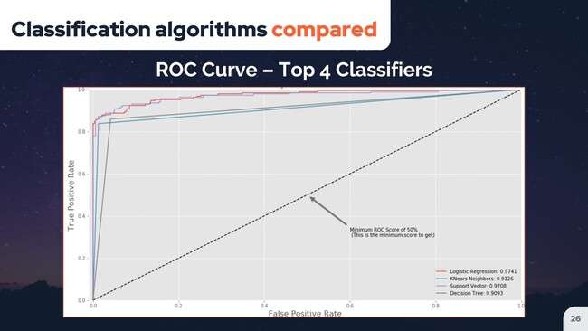
Classification Algorithm Compared ROC Curve – Top 4 Classifiers
Notes:
when we take a look at performance ratherthan using metrics of accuracy.Instead, we are going to use themeasure of receiver operating characteristics area underthe curve, or Rlcauc performance.
The RLC AUC is a very useful metricfor checking performance of the classification models, whichis what we're going to be building.
The Roc is a probability curve, while theAUC represents the degree or measure of separability.
Ultimately, this method of measurement gives us avalue between zero and one, with one beinga perfect score and zero being the opposite.
The higher the score, the betterprediction ability of the model.
We can even visualize this performanceby looking at the AUC curve.A confusion matrix is nota meaningful check for accuracy.For this type of data with unbalanced classification,true positives mean the rate of correctly classifiedfraud transactions, while true negatives are the rateof incorrectly classified fraud transactions.

Slide 24
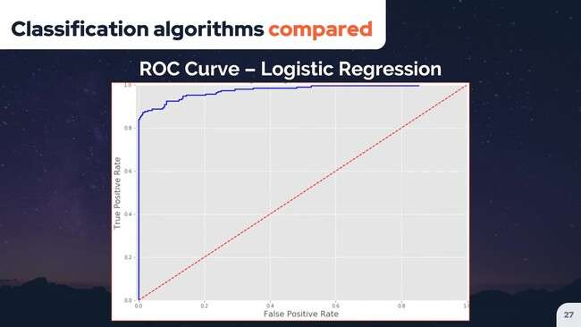
Classification Algorithm Compared ROC Curve – Logistic Regression
Notes:
By singling out the Roc curve forlogistic regression, we can see more clearlyhow well it performs for our data.

Slide 25
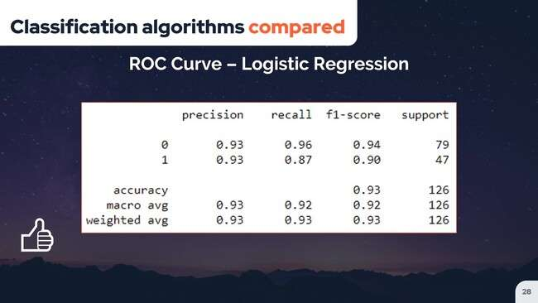
Classification Algorithms compared
ROC Curve – Logistic Regression
Notes:
After training our model, we thenmake predictions using our trained model.Precision is equal to the number oftrue positives divided by the total numberof true positives plus false positives.
Recall is equal to the number of true positives dividedby the total of true positives plus false negatives.The results using logistic regressionare more than acceptable.
The zero class, both transactions without fraudis predicted with a 94% precision and99% recall, whereas the one class transactionswhich are fraudulent has 97% precision.
This means that only 3% of the transactionswhich are fraudulent remain undetected by the system.

Slide 26
SUMMARY AND CONCLUSION
Notes:
In summary, by exploring, cleaning and preparingour data, we were able to uselogistic regression to produce an accurate modelfor predicting fraudulent credit card transactions.As always, this data can further beimproved by providing more training data.

